Slide 1
Stroke Prediction
Progress Report Presentation – July 6, 2022
MGTx 6203 Group Project – Team 30 – Summer 2022
Shitong Song
Melody Lin
Wen Yu
Mengchiao Li
Erfan Hajibandeh

Slide 2
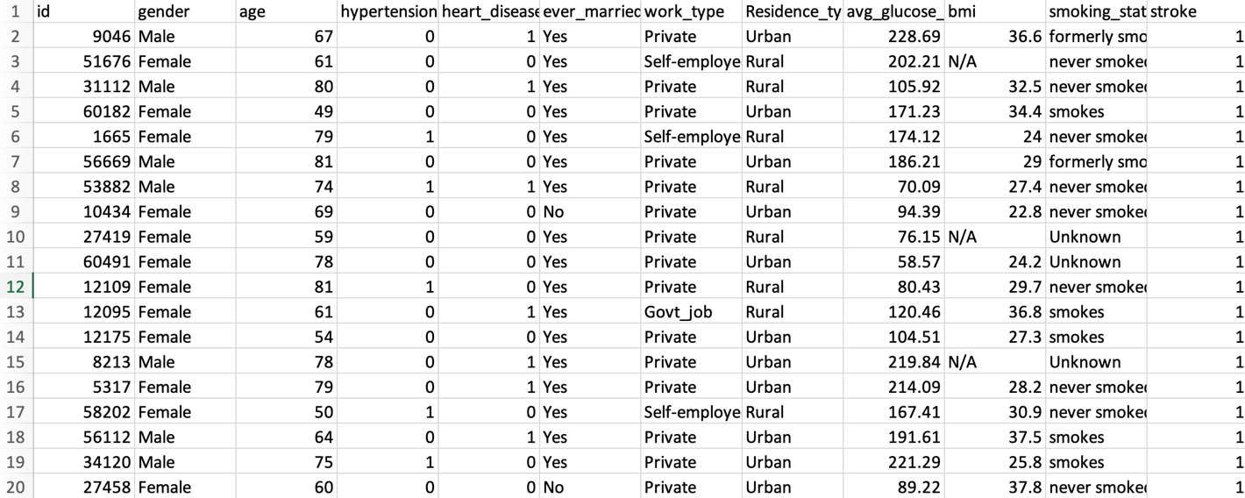
Data Set
Stroke Prediction Data Set from Kaggle*
*https://www.kaggle.com/datasets/fedesoriano/stroke-prediction-dataset

Slide 3
Data Set (Cont.)
The original dataset contains 5110 observations. Data cleaning was done to replace NAs and remove outliers.
Variable | Observation
"gender" | Imbalanced with 59% "Female" and 41% "Male".
“age” | There is enough data with an acceptable balance before 40 and after 40.
"hypertension" | - Approximately 90% "No" and 10% "Yes" - Significantly imbalanced
“heart_disease” | 95% "No" and 5% "Yes" - Significantly imbalanced
"ever_married" | Imbalanced with approximately 65% "Yes" and 35% "No".
"work_type" | Children Govt_job Never_worked Private Self-employed 14% 13% <1% 57% 16%
“residence_type” | 50% balanced between "rural" and "urban"
“avg_glucose_level” | Major heteroscedasticity can be observed from the histogram – Right skewed
“bmi” | Minor heteroscedasticity can be observed from the histogram – Right skewed
"smoking_status" | formerly smoked never smoked smokes Unknown 25% 38% 15% 22%
“stroke” | 4.3% indicating stroke and 95.7% with no stroke occurance

Slide 4
Analysis Objectives
General data analysis and prediction modelling
Will marriage increase the risk of getting a stroke?
Does stroke have a strong relation with other health indicator factors (such as smoking)?
Which predictors are most correlated with the rate of stroke?

Slide 5
Important Considerations
The "stroke" == 1 comprises only 5% of the data and cost analysis is required for each model.
The "smoking_status" has 22% of "uknown" category data points that may or may not be used in each model.
There is an imbalance between the Female and Male population.
There is heteroscedasticity for "bmi" and "avg_glucose_level".
Scaling is required when not using regression.

Slide 6
Modelling
Cleaning and splitting the data into a training set (70%), validation set (15%) and testing set (15%)
Using cross-validation to select the optimal parameters and model. Then, train the data using the following models to predict/classify the data:
Logistic Regression
Random Forest
SVM
KNN
Models comparison and answering objective questions

Slide 7
Preliminary Results
Logistic Regression: Not available yet
Random Forest: 100% accuracy on the testing set
SVM: 90.4% accuracy on the testing set
KNN: 83.3% accuracy on the testing set

Slide 8
Preliminary Results
Logistic Regression: Not available yet
Random Forest: 100% accuracy on the testing set
SVM: 90.4% accuracy on the testing set
KNN: 83.3% accuracy on the testing set

Slide 9
Conclusion
High accuracies were observed because 95% of data is Stroke =1 and only 5% is Stroke =0. Cost analysis should be done to maximize the penalty of False negatives while maintaining an acceptable model efficiency.
TO BE CONTINUED…

